Slide 1



Box2D with Javascript
&
Brown bag series
“A practical introduction to 2d physics”
Eden House, London. 21st May 2014

Slide 2

Agenda
Download the template
What is Box2D?
Showcase some examples
A little bit of coding…
Useful links

Slide 3

Download the template
http://github.com/gazpachu/box2d.git
http://github.com/gazpachu/box2d/archive/master.zip
It includes this presentation and the step-by-step tutorial

Slide 4
What is Box2D
dynamic
World
editor
static
Gravity
vector
Bodies
Collisions
?
awake
density
sleeping
Fixtures
Shapes
friction
Velocity
Impulse
Inertia
sensor
restitution
debug draw
Force
Joints
bullet
Torque
Damping
Mass

Slide 5

Box2D is a free open source 2-dimensional physics simulator engine written in C++ by Erin Catto.
It has been used in many online Flash games as well as Nintendo DS, Wii, Javascript, iPhone, iPad and Android games using the Cocos2d or the Corona framework.

Slide 6
It can simulate bodies composed of convex polygons, circles, and edge shapes. Bodies can be joined together with joints and acted upon by forces. The engine also applies gravity, friction, and restitution. It also has collision detection.

Slide 7
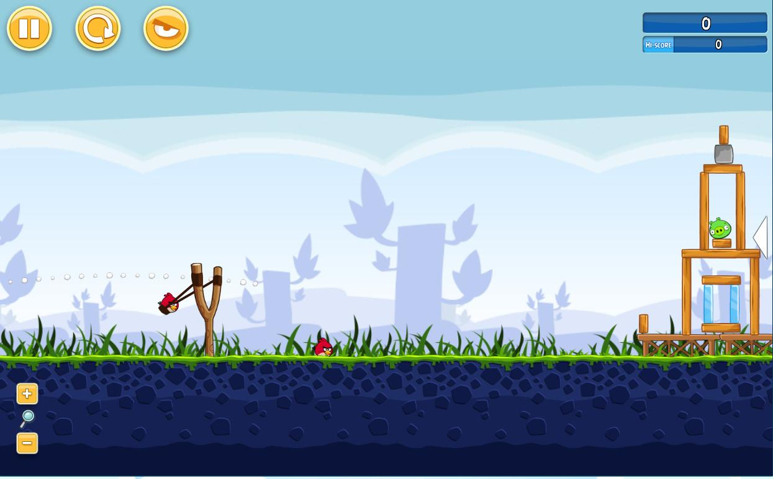
Angry Birds for Chrome (made with PlayN and a GWT port of Box2d)
http://chrome.angrybirds.com

Slide 8

ICA Art Rules (made with RoR and Box2d by SapientNitro)
http://artrules.ica.org.uk

Slide 9
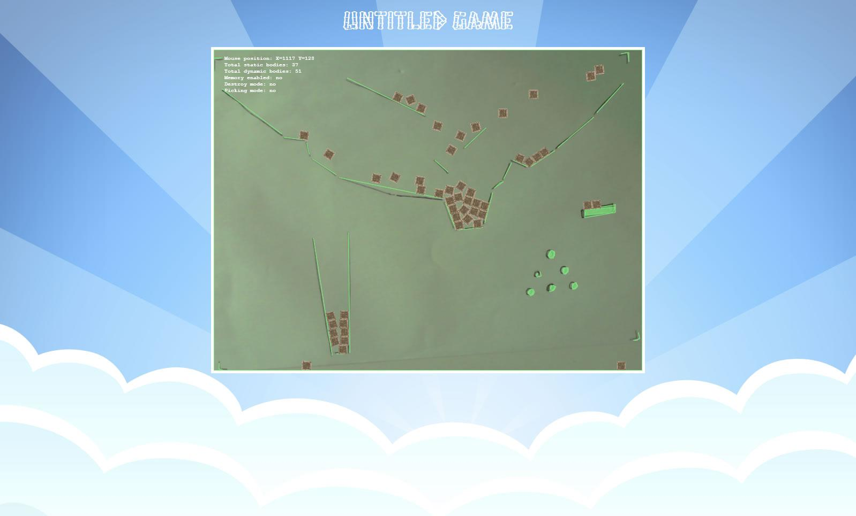
Real time shape recognition demos (box2d and openCV)

Slide 10
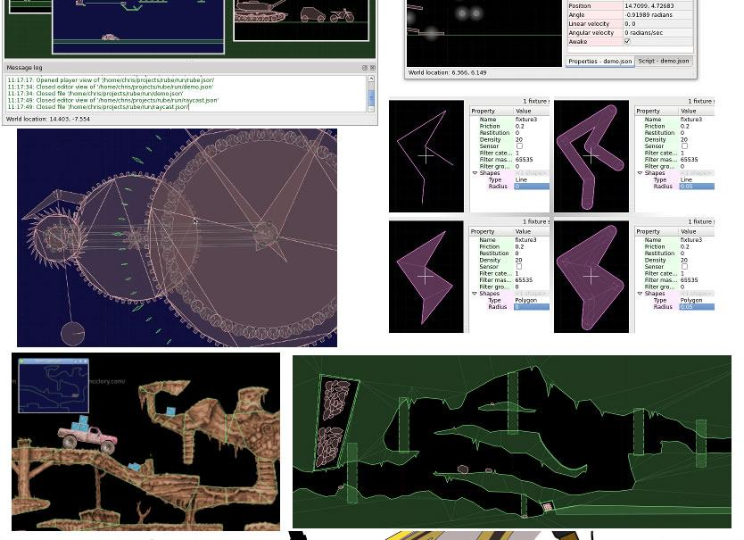
R.U.B.E. (Really Useful Box2D Editor)
https://www.iforce2d.net/rube

Slide 11

Coding time...
open the “box2d” folder in
your favourite text editor...
var b2Vec2 = Box2D.Common.Math.b2Vec2;
var b2AABB = Box2D.Collision.b2AABB;
var b2BodyDef = Box2D.Dynamics.b2BodyDef;
var b2Body = Box2D.Dynamics.b2Body;
var b2FixtureDef = Box2D.Dynamics.b2FixtureDef;
var b2Fixture = Box2D.Dynamics.b2Fixture;
var b2World = Box2D.Dynamics.b2World;
var b2PolygonShape = Box2D.Collision.Shapes.b2PolygonShape;
var b2DebugDraw = Box2D.Dynamics.b2DebugDraw;

Slide 12
Box2D Library & Docs
Box2D JS Tutorials
iForce Tutorials
https://code.google.com/p/box2dweb/
http://www.emanueleferonato.com/category/box2d
http://www.iforce2d.net/b2dtut/

Slide 13

Thanks ;-)

